Slide 1

Move More,
Feel Better
Grades 7–9
Together For Health

Slide 2
60%
of Canadian youth are not meeting the 60-minute daily physical activity guideline
And screen time has doubled since the pandemic, replacing movement for millions of teens.
Together For Health

Slide 3
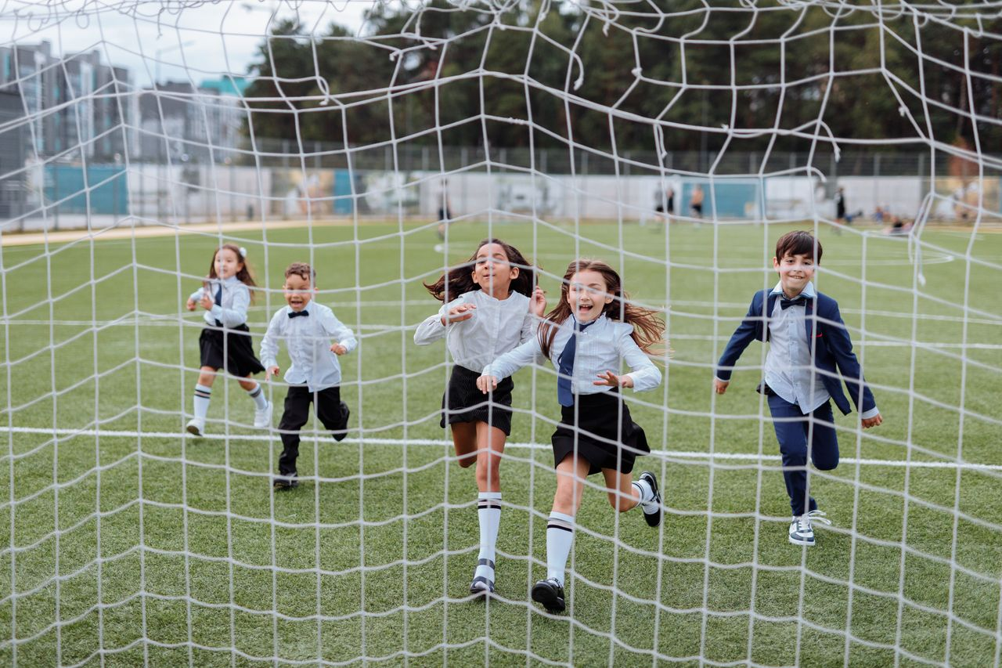
🧬
Exercise Changes Your Brain
Aerobic exercise triggers release of BDNF — "fertilizer for the brain"
Increases hippocampus size — improves memory and learning
Reduces cortisol (stress hormone) and increases endorphins
Regular exercise reduces depression and anxiety as effectively as medication
Increases focus and attention for 2–4 hours after a workout
Together For Health

Slide 4
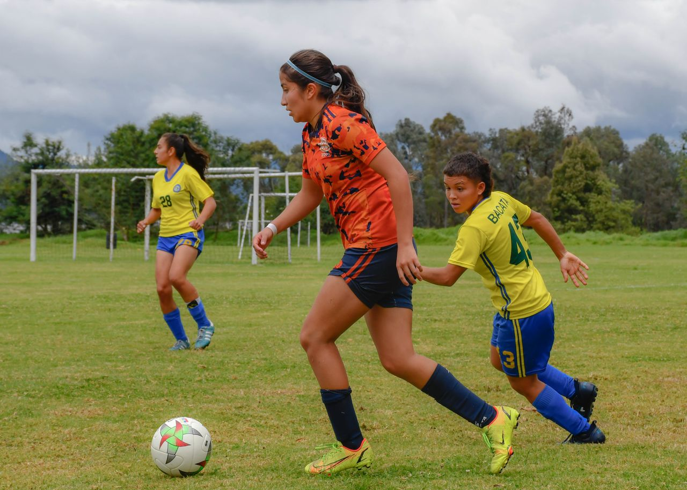
📱
Sedentary Behaviour — The Hidden Risk
Sitting 6+ hours a day increases risk of heart disease by 40%
Screen time over 4 hours linked to depression in teens
Sedentary behaviour is independent of exercise — you can exercise daily and still sit too much
Take movement breaks: stand, stretch, or walk for 5 min every hour
Replace screen time with active alternatives — sports, walking, dancing
Together For Health

Slide 5
📋
Building an Active Routine
Choose activities you actually enjoy — sustainability is key
1
Start small: 15-20 min daily and build up
2
Include all three types: cardio + strength + flexibility
3
Use micro-movements: stairs not elevators, walk not ride
4
Track progress — it increases motivation and consistency
5
Together For Health

Slide 6

💊
Exercise Is Medicine
Exercise reduces the risk of depression by 25% and improves academic performance by up to 15%.
No prescription required, no side effects, no cost. The most powerful health intervention available.
Together For Health

Slide 7
KEY TAKEAWAYS
Movement is the most accessible health intervention available
✓
The benefits begin in minutes and last for hours
✓
You do not need a gym — your body is the equipment
✓
Resources
ParticipACTION: participaction.com
Canada 24-Hour Movement Guidelines: csepguidelines.ca
Try: 7-Minute Workout app — free, no equipment
Together For Health

